Slide 1
Templates

Slide 2
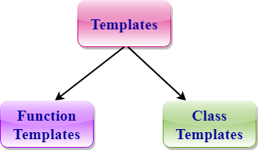
Templates
A C++ template is a powerful feature added to C++.
It allows you to define the generic classes and generic functions and thus provides support for generic programming.
Generic programming is a technique where generic types are used as parameters in algorithms so that they can work for a variety of data types.

Slide 3
Function Templates:
We can define a template for a function. For example, if we have an add() function, we can create versions of the add function for adding the int, float or double type values.
Class Template:
We can define a template for a class. For example, a class template can be created for the array class that can accept the array of various types such as int array, float array or double array.

Slide 4
Function Template
Generic functions use the concept of a function template. Generic functions define a set of operations that can be applied to the various types of data.
The type of the data that the function will operate on depends on the type of the data passed as a parameter.
For example, Quick sorting algorithm is implemented using a generic function, it can be implemented to an array of integers or array of floats.
A Generic function is created by using the keyword template. The template defines what function will do.

Slide 5
Syntax of Function Template
template < class Ttype> ret_type func_name(parameter_list)
{
// body of function.
}
Where Ttype: It is a placeholder name for a data type used by the function. It is used within the function definition. It is only a placeholder that the compiler will automatically replace this placeholder with the actual data type.
class: A class keyword is used to specify a generic type in a template declaration.

Slide 6
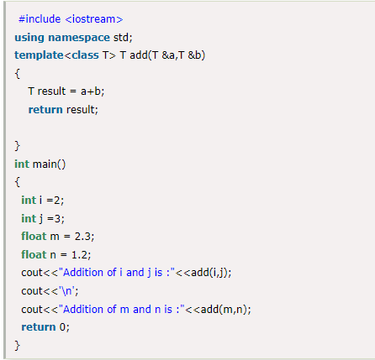
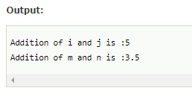
e.g

Slide 7
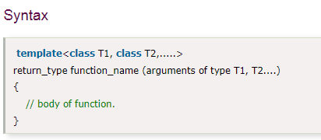
Function Templates with Multiple Parameters
We can use more than one generic type in the template function by using the comma to separate the list.

Slide 8
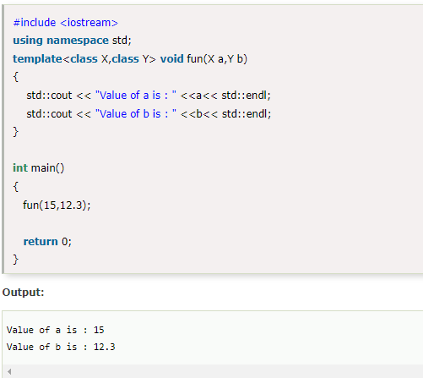
e.g

Slide 9
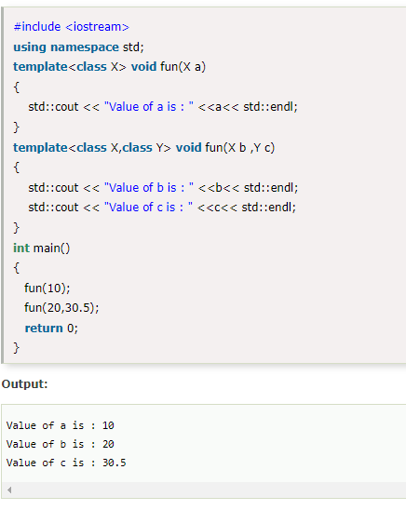
Overloading a Function Template
We can overload the generic function means that the overloaded template functions can differ in the parameter list.

Slide 10
CLASS TEMPLATE
Class Template can also be defined similarly to the Function Template. When a class uses the concept of Template, then the class is known as generic class.
Syntax
template<class Ttype>
class class_name
{
.
.
}

Slide 11
Ttype is a placeholder name which will be determined when the class is instantiated. We can define more than one generic data type using a comma-separated list. The Ttype can be used inside the class body.
Now, we create an instance of a class
class_name<type> ob;
where class_name: It is the name of the class.
type: It is the type of the data that the class is operating on.
ob: It is the name of the object.

Slide 12
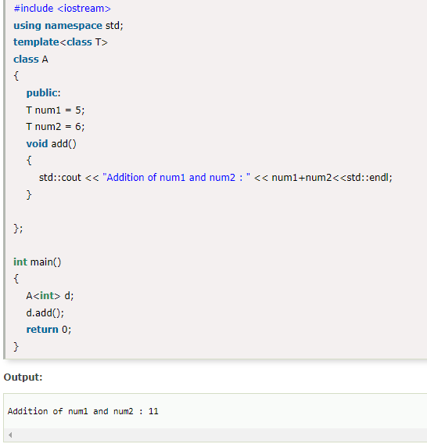

Slide 13
CLASS TEMPLATE WITH MULTIPLE PARAMETERS
We can use more than one generic data type in a class template, and each generic data type is separated by the comma.
Syntax
template<class T1, class T2, ......>
class class_name
{
// Body of the class.
}

Slide 14
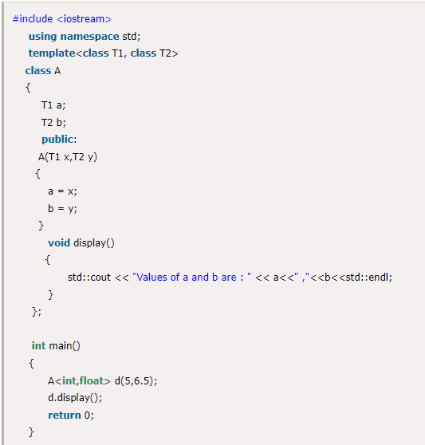
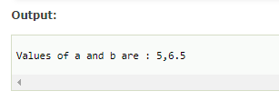
e.g

Slide 15
Nontype Template Arguments
The template can contain multiple arguments, and we can also use the non-type arguments In addition to the type T argument, we can also use other types of arguments such as strings, function names, constant expression and built-in types.
template<class T, int size>
class array
{
T arr[size]; // automatic array initialization.
};
In the above case, the nontype template argument is size and therefore, template supplies the size of the array as an argument.
Arguments are specified when the objects of a class are created:
array<int, 15> t1; // array of 15 integers.
array<float, 10> t2; // array of 10 floats.
array<char, 4> t3; // array of 4 chars.

Slide 16
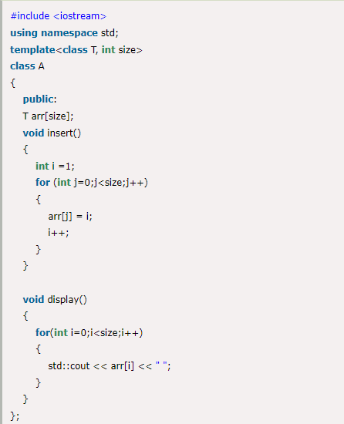
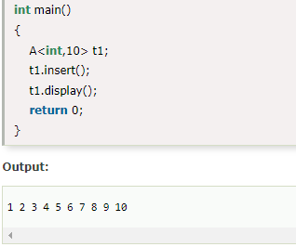
e.g

Slide 17
Points to Remember
C++ supports a powerful feature known as a template to implement the concept of generic programming.
A template allows us to create a family of classes or family of functions to handle different data types.
Template classes and functions eliminate the code duplication of different data types and thus makes the development easier and faster.
Multiple parameters can be used in both class and function template.
Template functions can also be overloaded.
We can also use nontype arguments such as built-in or derived data types as template arguments.

